Slide 1
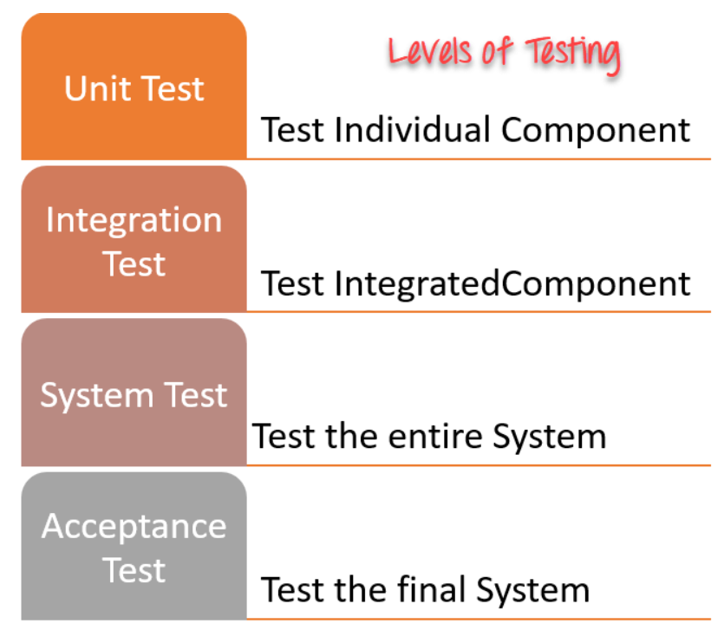
Levels of Testing

Slide 2
Unit Testing:
Scope: Individual units or components of the software, such as functions, methods, or classes, are tested in isolation.
Purpose: To verify that each unit performs as expected and to identify defects early in the development process.
Tools: Testing frameworks like JUnit, NUnit, or Pytest are commonly used for unit testing.
Integration Testing:
Scope: Interactions between different units or components of the software are tested to ensure that they work together as intended.
Purpose: To verify that the integrated system functions correctly and that data is passed between components without loss or corruption.
Approaches: Top-down, bottom-up, incremental, or big bang integration testing are commonly used, depending on the project's requirements.
System Testing:
Scope: The entire software system is tested as a whole to validate its compliance with specified requirements and to evaluate its overall functionality, performance, and usability.
Purpose: To assess the system's behavior under various conditions and to identify defects or inconsistencies that may arise during real-world usage.
Types: Functional testing, non-functional testing (e.g., performance, security, usability), and regression testing are commonly performed during system testing.

Slide 3
Acceptance Testing:
Scope: The software is tested from the end-users' perspective to determine whether it meets their requirements and business objectives.
Purpose: To gain confidence that the software is ready for deployment and to obtain approval from stakeholders for its release.
Types: User acceptance testing (UAT), alpha testing, and beta testing are common forms of acceptance testing, each involving different stakeholders and objectives.
Regression Testing:
Scope: Previously tested software features are retested to ensure that recent changes or fixes have not adversely affected existing functionality.
Purpose: To detect and prevent regression defects introduced by new code changes or system modifications.
Automation: Regression testing is often automated to facilitate frequent execution and to ensure comprehensive test coverage.
Smoke Testing:
Scope: Basic functionality of the software is quickly verified to ensure that critical features are working before more comprehensive testing is performed.
Purpose: To identify major defects or show-stopper issues early in the testing process, allowing development teams to address them promptly.
Focus: Smoke tests are typically focused on key functionalities or critical paths of the application.

